Slide 1
Image Processing
CSC 532
Dhaval
Kavya

Slide 2
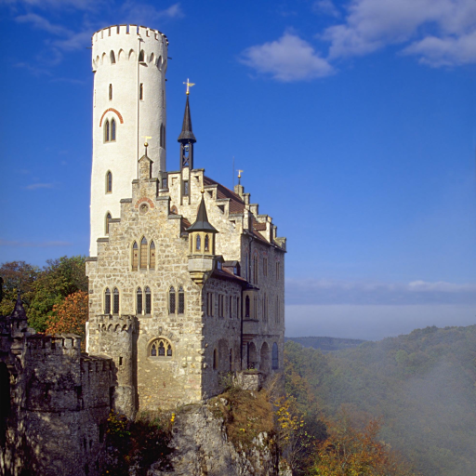
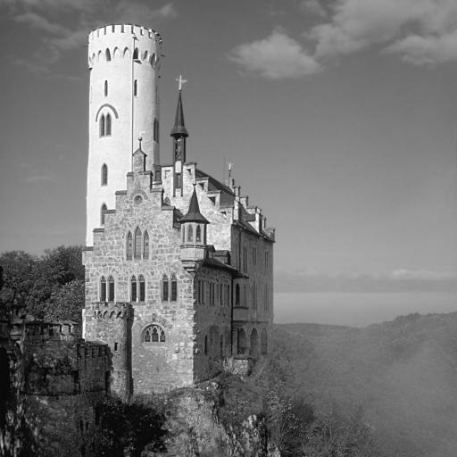
Gray Scale

Slide 3
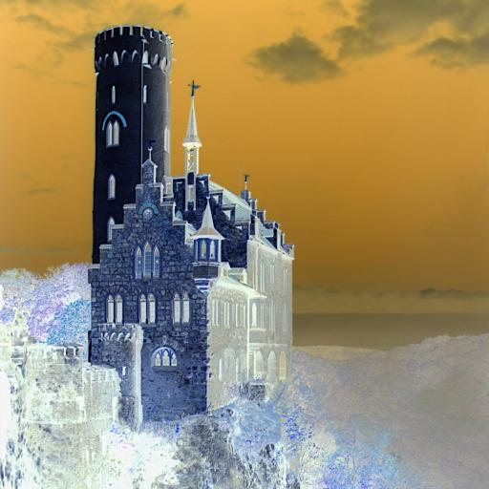
Negative

Slide 4
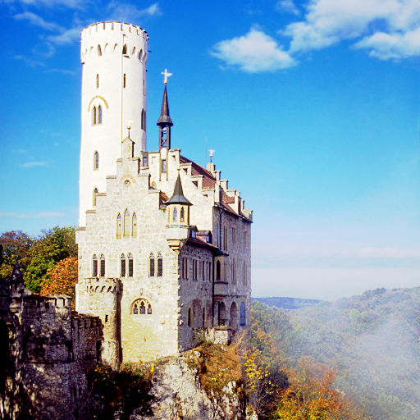
Histogram Equalization

Slide 5
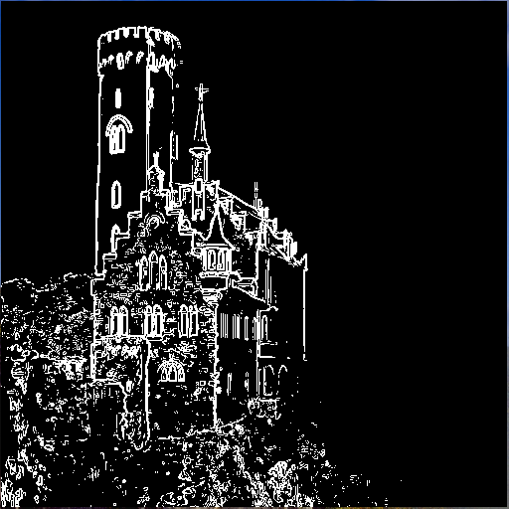
Edge Detection – Sobel Mask

Slide 6
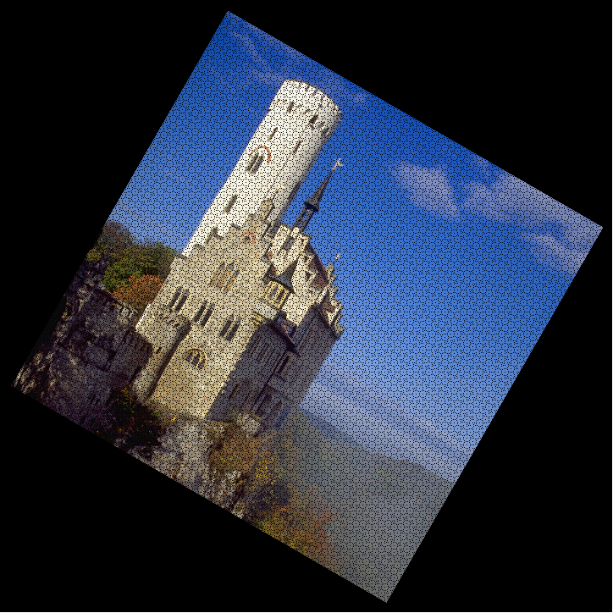
Rotation

Slide 7
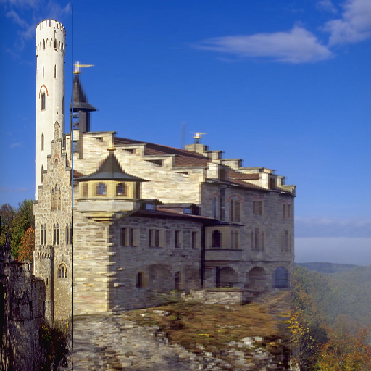
Warp – Horizontal direction

Slide 8
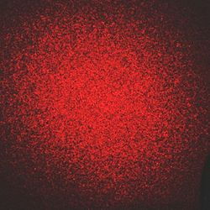
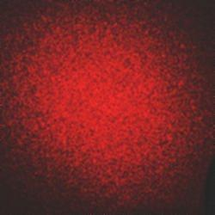
Speckle Remove

Slide 9
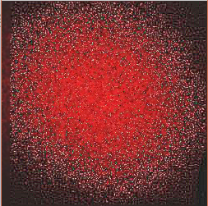
Sharpening

Slide 10
Smoothening

Slide 11


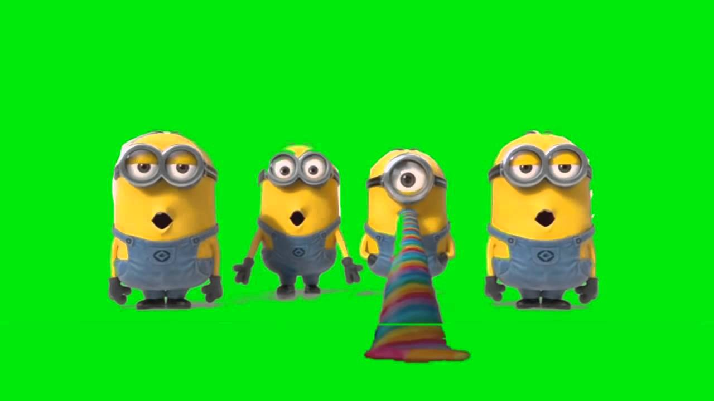
Image Composition

Slide 12


Image Fading

